Slide 1
Beyond Pentodes Audio use of odd tubes
Pete Millett
ETF.24

Slide 2
Agenda
A little biography
Why would I use non-traditional audio tubes?
Beyond pentodes – heptodes, hexodes, octodes, nonodes
Weird tubes – gated beam discriminators, sheet beam tubes…
Odd high frequency triodes
Multi-element tubes
Image credit to many sources online, especially the Valve Museum – www.r-type.org

Slide 3
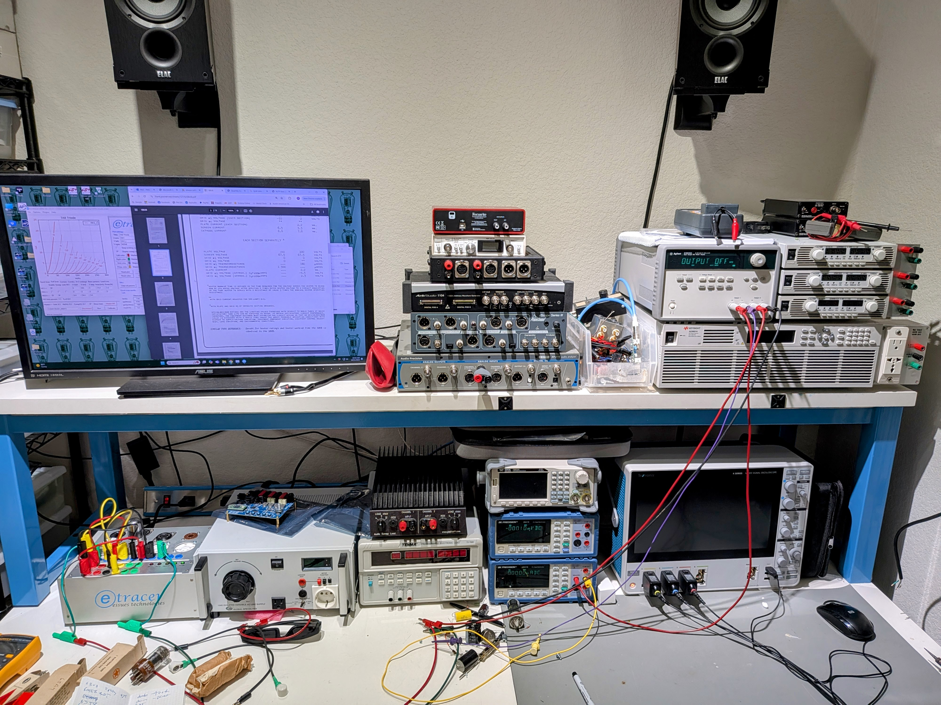
Biography
I’ve been coming to ETF since 2003
I’ve been an Electrical Engineer for almost 40 years, live in Austin, TX and work from a lab in my home
I was a board level hardware guy in consumer and computers, but I’ve spent the last 20 years working for semiconductor companies
Have a hobby business doing DIY audio stuff
www.pmillett.com
pmillett@hotmail.com

Slide 4
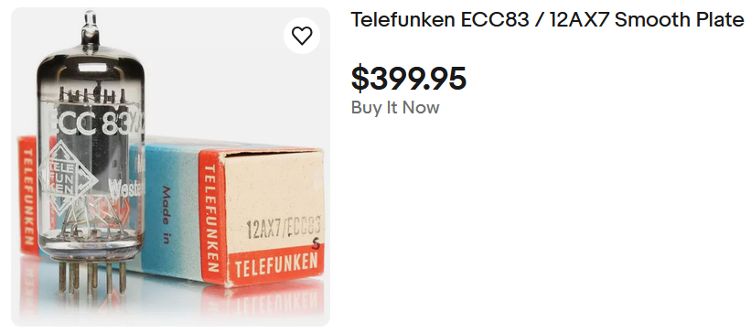
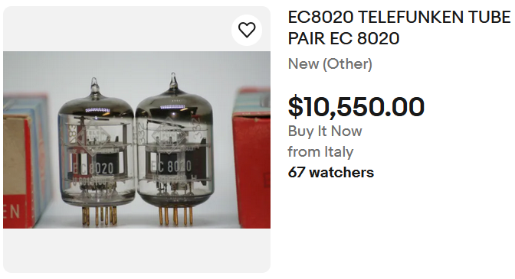
Why bother with these odd (non-audio) tubes?
All the “treasured” audio tubes have become scarce – and expensive!
A plain old 6SN7 or 12AX7 now sells for between €30 and €150 each – sometimes much more!
An NOS EF86 pentode sells for €100, and it often can be replaced by a lowly 6AU6/EF94 for less than €10
Meanwhile, there are thousands of tube types that sell for €1 or less
For example, www.vacuumtubes.net has several hundred types listed for $0.75 – even less if you buy in quantity
Notes:
I’m sorry, but $400 for a 12AX7 or over $10k for a pair of EC8020 tubes? That is insane.

Slide 5
Better performance!
Many of these odd tubes perform as well – or better – than the old standards
Often they contain the exact same internal structures as the expensive tubes
Many tubes developed for non-audio use perform far better than typical audio tubes
Tube technology was at its peak when tubes were developed for color TVs before the transition to silicon
For example, lots of high-gm pentodes were made for color TV video amplifier use, some with gm over 20mA/V. These make awesome audio amplifiers
Triodes were developed for UHF use that have high gm and low noise
Some have already been discovered, driving up the price
The D3a high gm pentode used to be cheap… now it sells for $50-100
But there are lots of others out there. Look up 6HM6… gm = 15mA/V, for $3. The only reason it is $3 is that it is “undiscovered” by audiophiles. (Did I just ruin that?)

Slide 6
Multi-grid tubes Hexodes, Heptodes, Octodes and more…
Notes:
We all know what diodes, triodes, tetrodes, and pentodes are. But there are tubes with more electrodes inside…

Slide 7
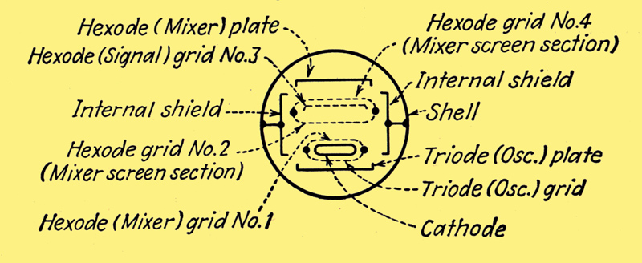
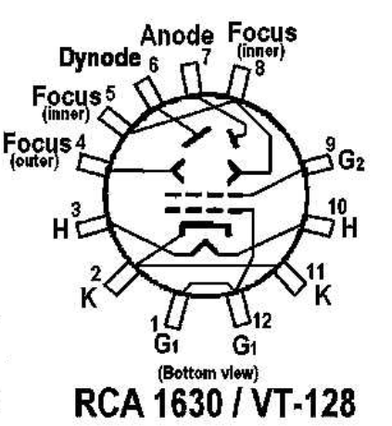
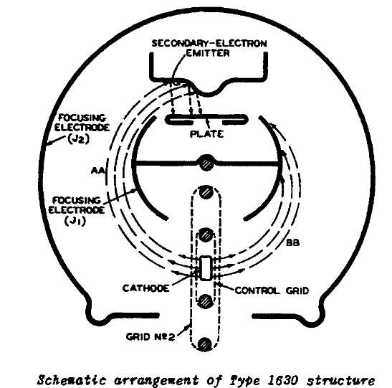
Hexodes
A hexode has 4 grids
Some hexodes are just pentodes with an extra grid inserted between G1 and G2
These are RF amplifiers like 6GU5 and 6FS5, which basically function
the same as pentodes
The AH1 and RENS1224 are hexodes designed as a mixer
Triode-hexode tubes contain a triode intermingled
with a hexode
There are several “triode hexode” tubes, which combine a triode in the same envelope as a hexode, with a shared and cathode and two plates, and often a shared G1
ECH11, ECH35, ECH41, ECH81/6AJ8, ECH83, ECH84, and 6K8 are examples
These were used as oscillator/mixers, especially in Europe
There are some unusual ones – like the 1630
orbital-beam amplifier
This was designed as a wideband UHF amplifier

Slide 8
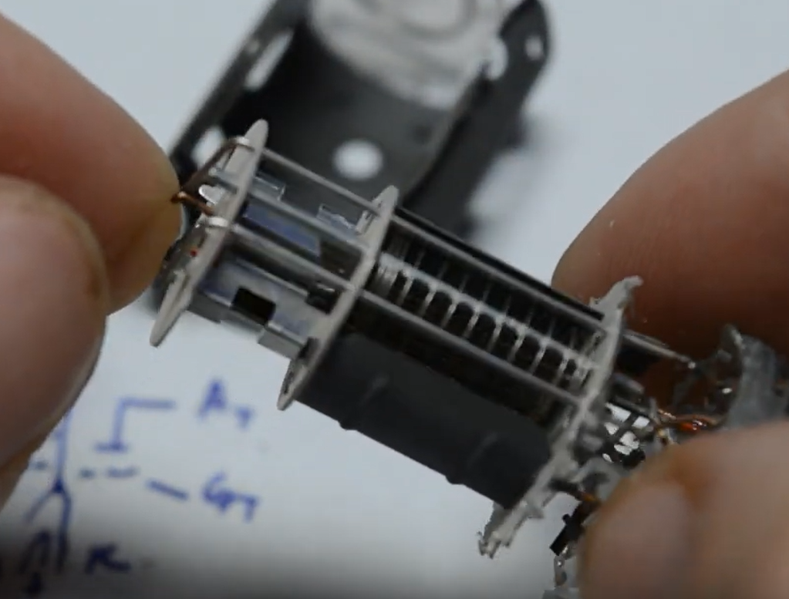
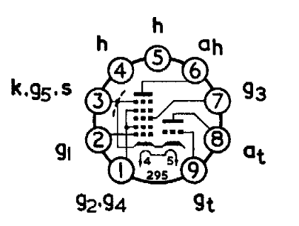
Triode-hexode example: ECH81 / 6AJ8
The ECH81 was a popular mixer tube for AM radios in Europe
It’s pretty much a pentode and triode that share the cathode
If you ground the triode plate you should get more-or-less a beam pentode
But no regular curves in the datasheets
You can also triode connect it but it isn’t very linear
The triode section is a separate, normal triode with gm 0f 3.2mA/V and mu of 19
Image credit to Fesz on YouTube
Notes:
Unfortunately USPS lost the tubes I was going to test. But looking at the datasheet it may not be very useful.

Slide 9
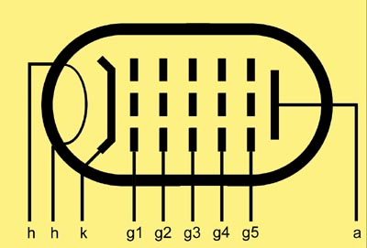
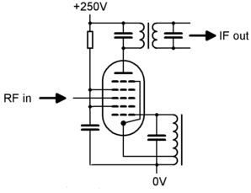
Heptodes and pentagrid converters
A heptode, AKA pentagrid converter, has 5 grids
They figured out you could add two grids to a pentode and make a combined oscillator and mixer for an AM radio, eliminating the oscillator tube
One of the grids acted as the oscillator plate
For transformerless “AA5” AM radios in the US, the 12SA7 and then the 12BE6 were common
There are many others – most are dirt cheap
You can make these into triodes by connecting them similarly to how you would connect a pentode – hook all the grids except G1 to the plate
You can also connect these as pentodes by using G2 and G4 as the screen and connecting G3 and G5 to the cathode

Slide 10
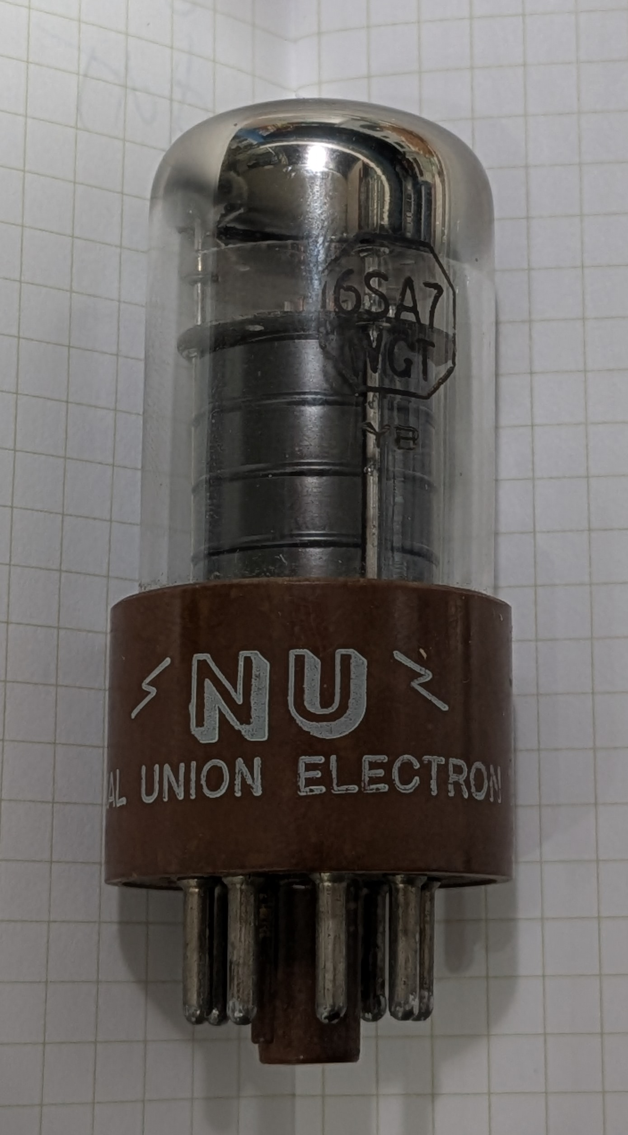
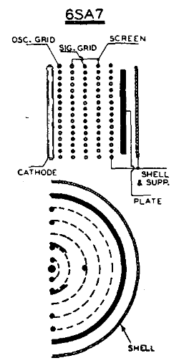
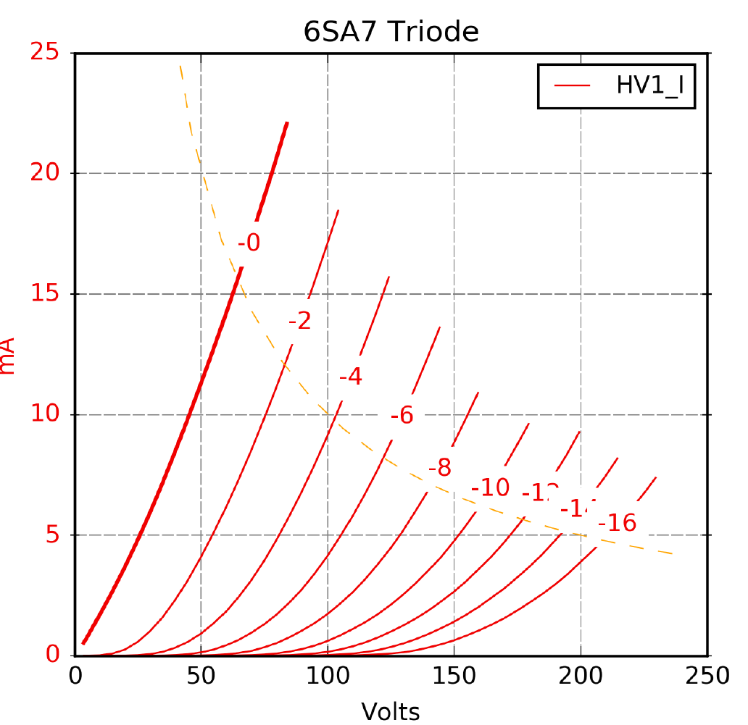
Pentagrid example: 6SA7 in triode mode
The 6SA7 is an octal pentagrid converter. Connected with G2, G3, G4, and G5 connected to the plate, you get a decent low-mu triode with a gm of ~2.5 mA/V and a mu of 12.7
Notes:
The 6SA7 costs $3.00… And it’s lovely looking

Slide 11
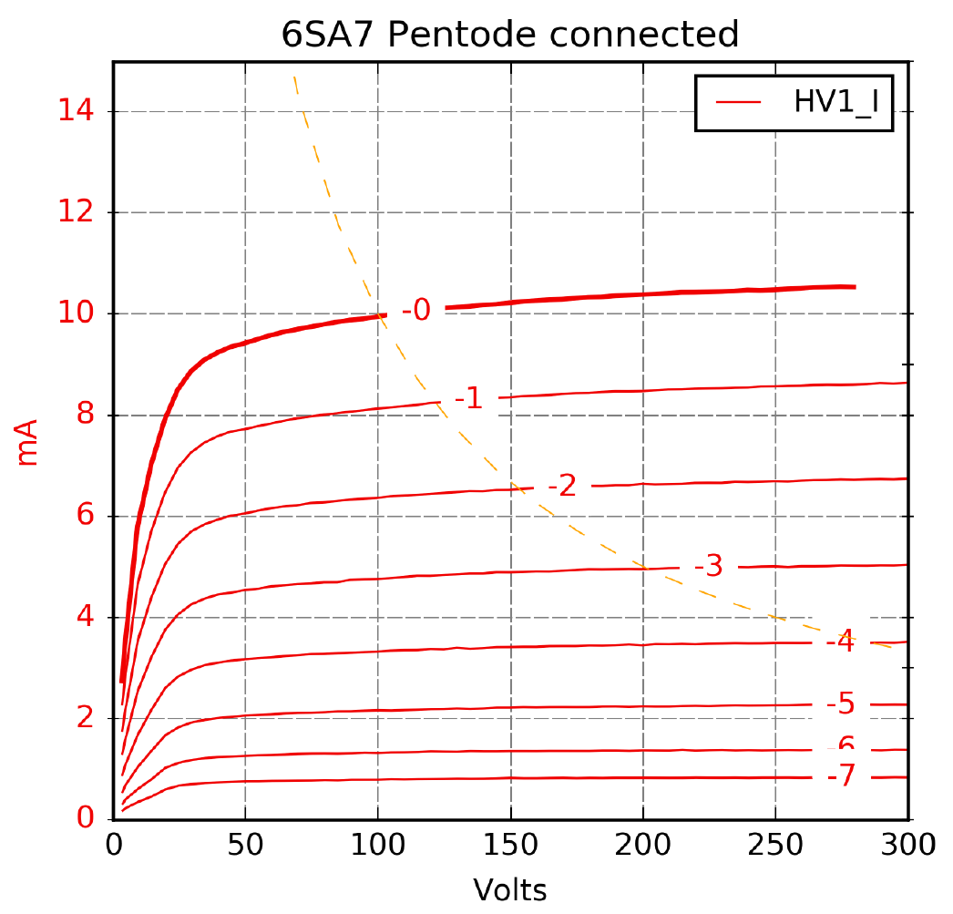
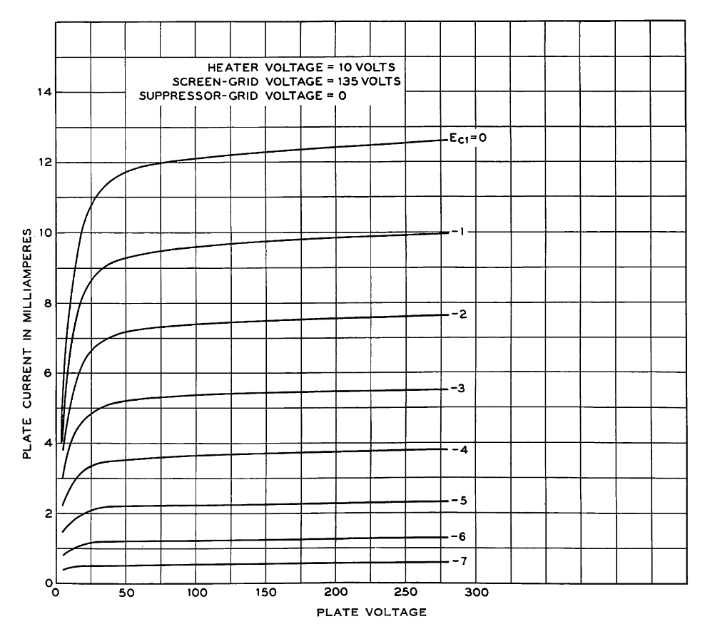
Pentagrid example: 6SA7 in pentode mode
To act as a pentode, G2 and G4 are the screen grid, and G3 and G5 are the suppressor
This makes a pretty audio good pentode! Compare it to the ($100) WE310A:
Notes:
Well, the 6SJ7GT only costs $11.00…

Slide 12
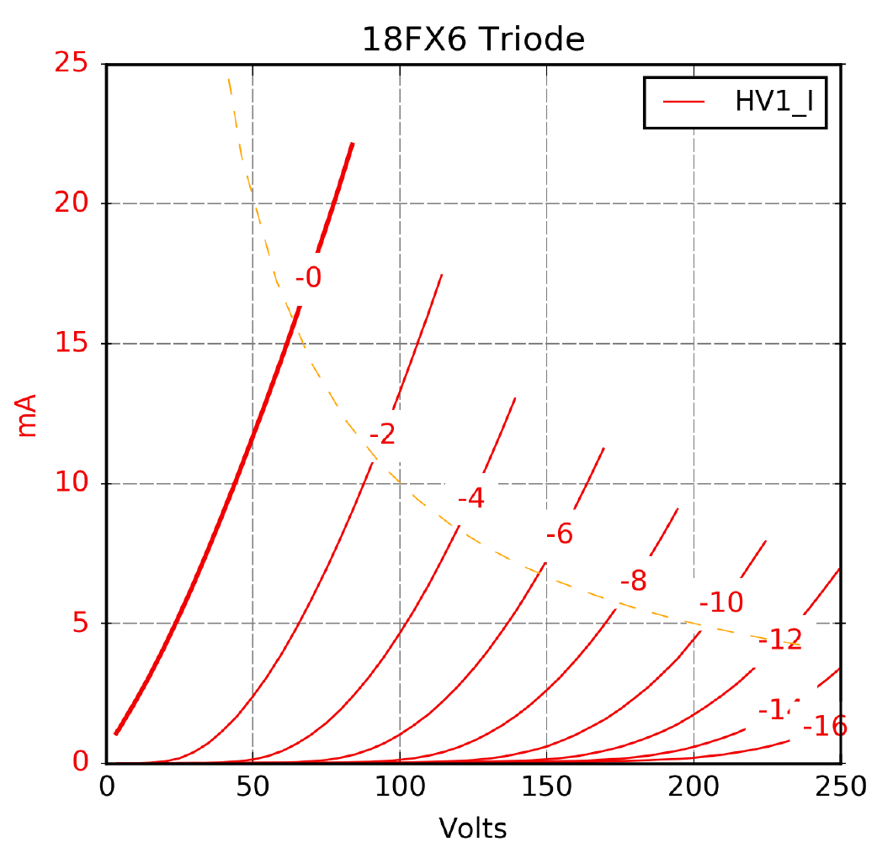
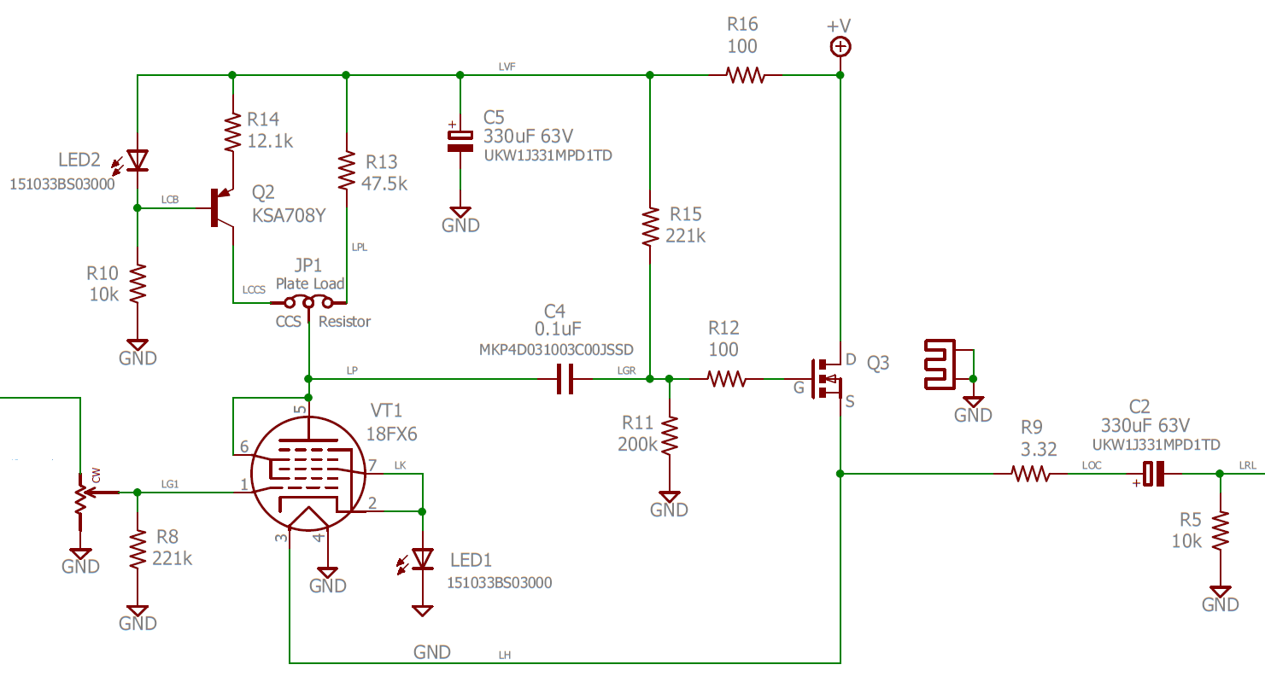
Pentagrid example: 12BE6 or 18FX6 in triode mode
The 12BE6 and 18FX6 are 7-pin-mini pentagrid converters. Connected with G2 and G4 connected to the plate, you get a medium-mu triode with a gm of ~4 mA/V and a mu of 18
Notes:
I used 18FX6 for a headphone amp kit at DIYAudio. I bought several hundred for about $0.50 each.

Slide 13
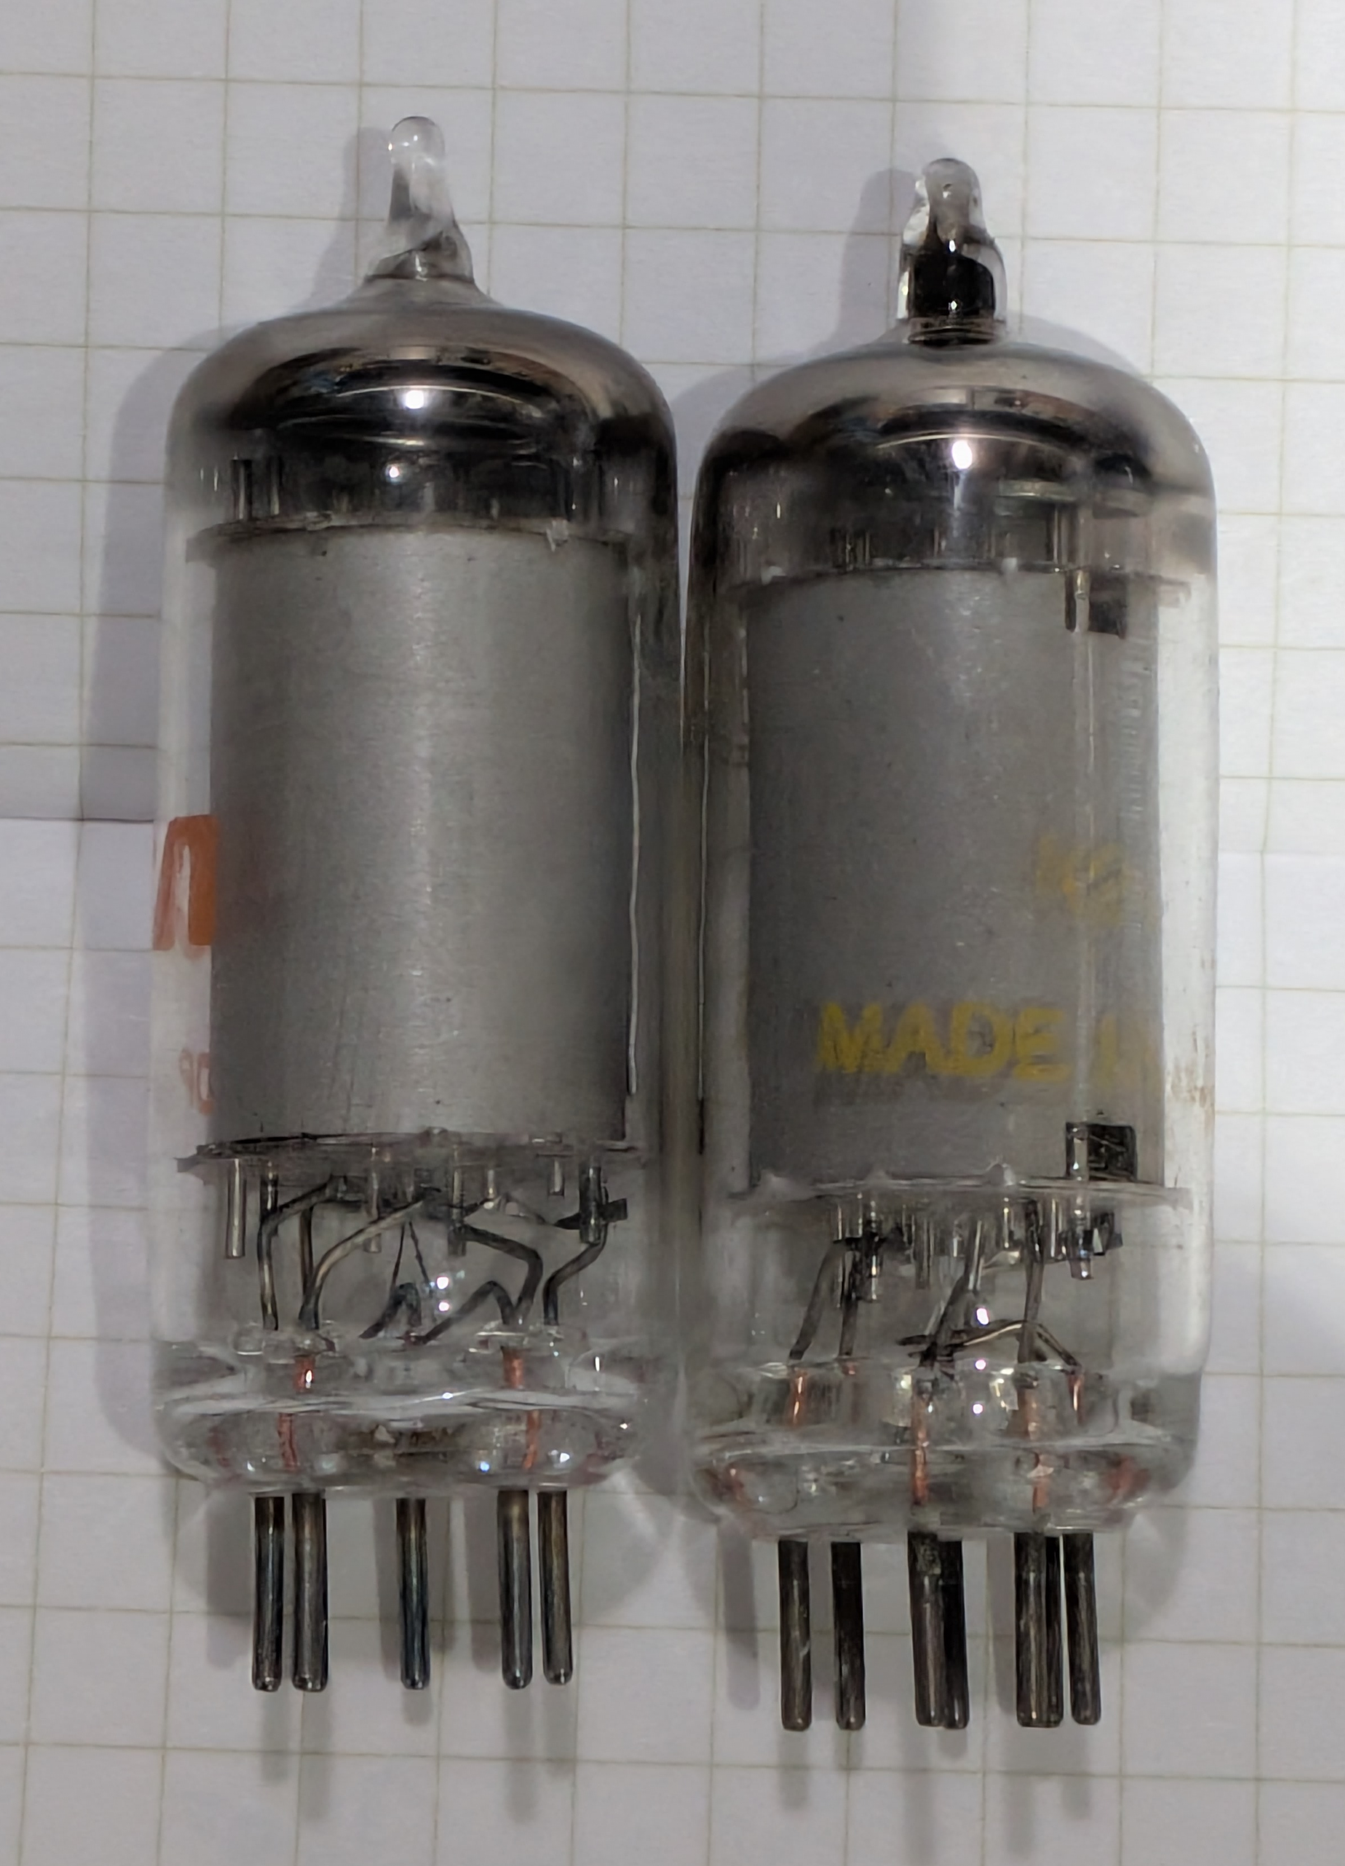
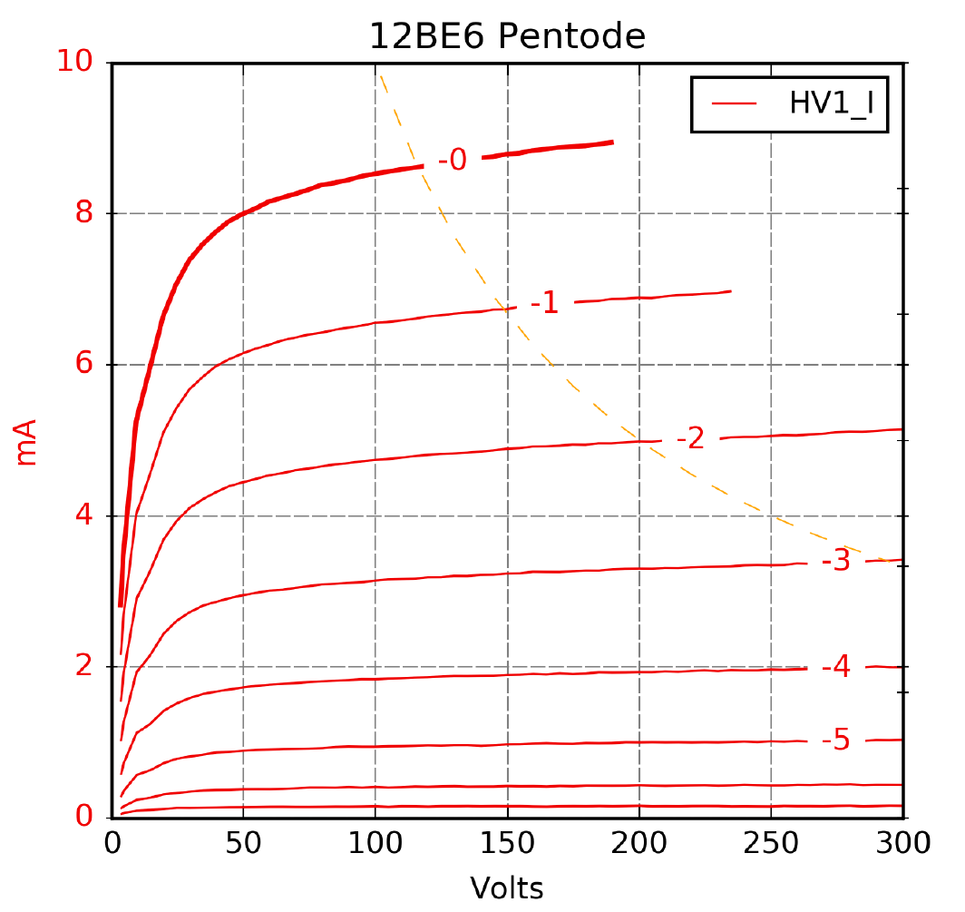
Pentagrid example: 12BE6 in pentode mode
G2 and G4 are the screen grid, and G3 and G5 are the suppressor

Slide 14
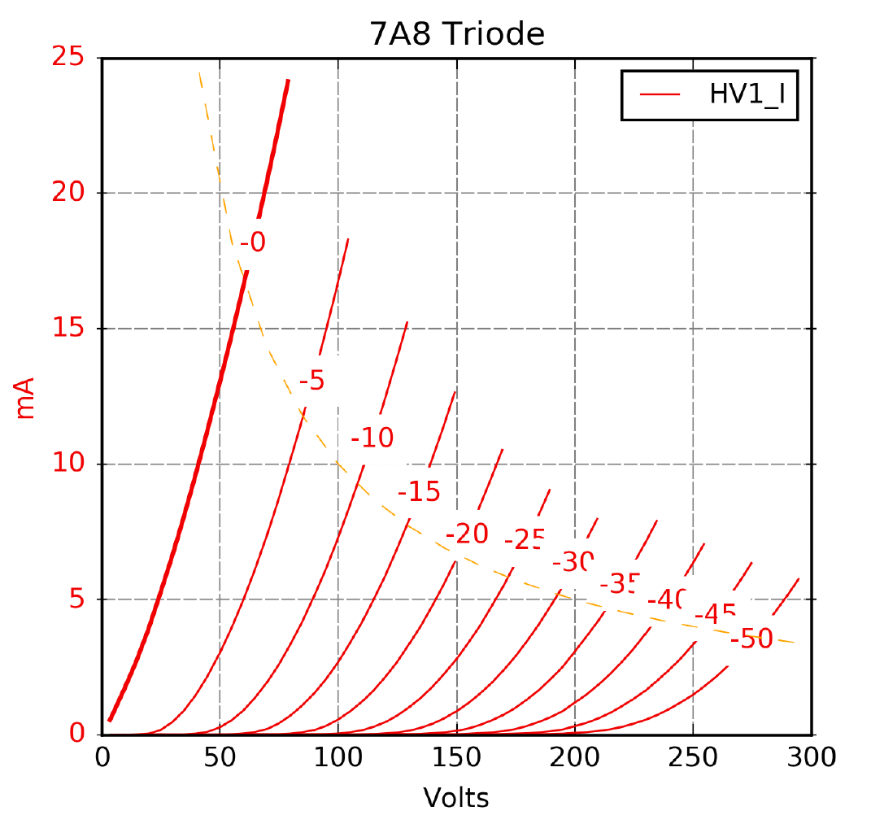
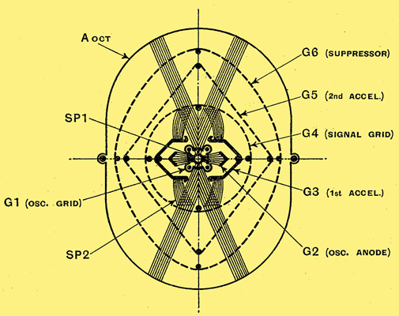
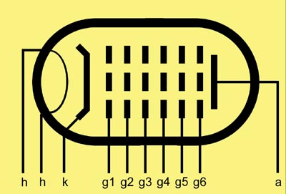
Octodes
If you add one more suppressor grid to a heptode (for a total of 6 grids) you get an octode
These are also used as oscillator/mixers
These are pretty uncommon
The US 7A8 and old EU EK3 are examples
The 7A8 triode connected (G2 – G6 connected to plate) is similar to the pentagrids
gm 1.1 mA/V, mu 5.2

Slide 15
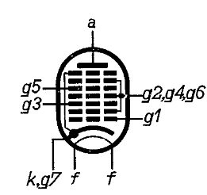
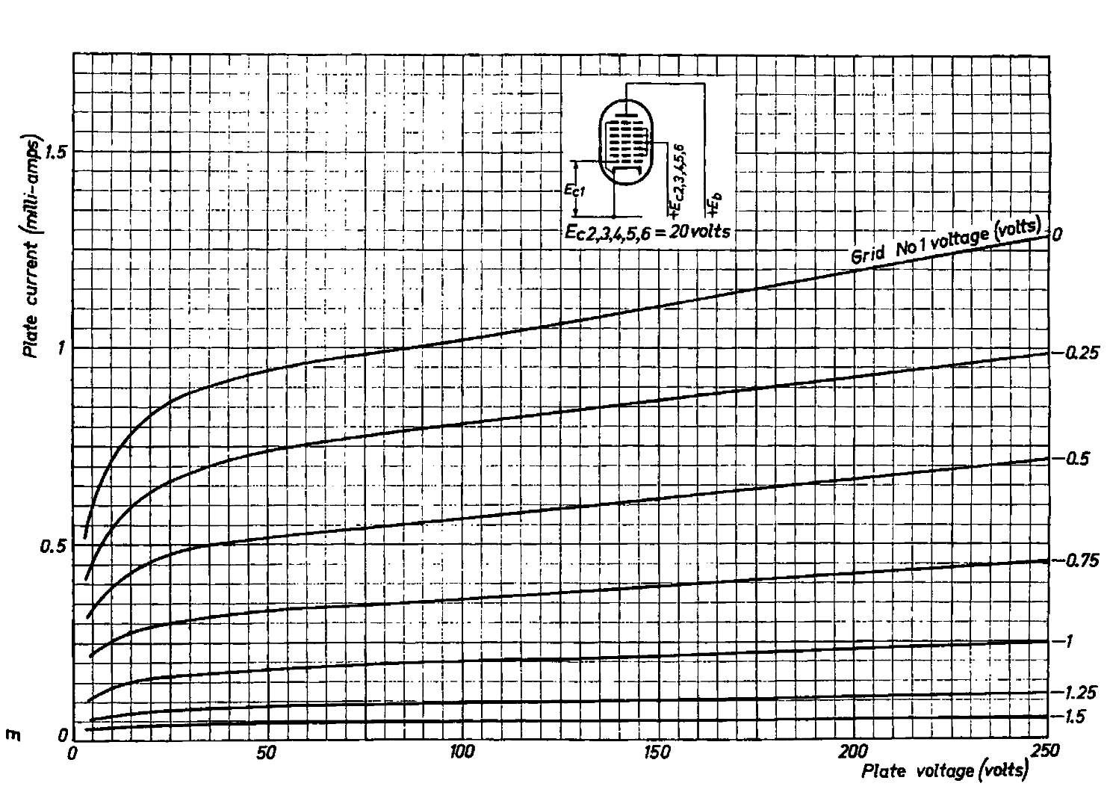
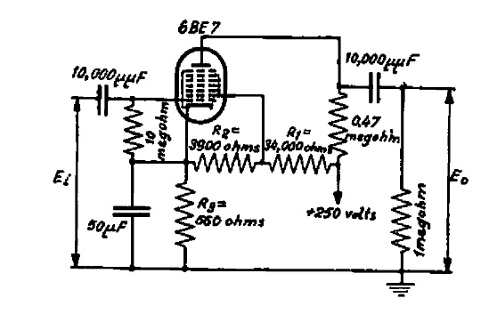
Nonodes (AKA Ennodes)
A nonode (or ennode) has 7 grids (!)
These are uncommon. The EQ80 / 6BE7 is about the only example I could find
Several grids are connected together inside the tube
The EQ80 was used mostly as an FM detector
It makes a pretty good pentode with only 20V on the “screen”
Philips also published a circuit to use it as an audio amplifier
It is cheap
Audio amp circuit
Pentode curves

Slide 16
The really weird stuff Surprisingly, some are useful

Slide 17
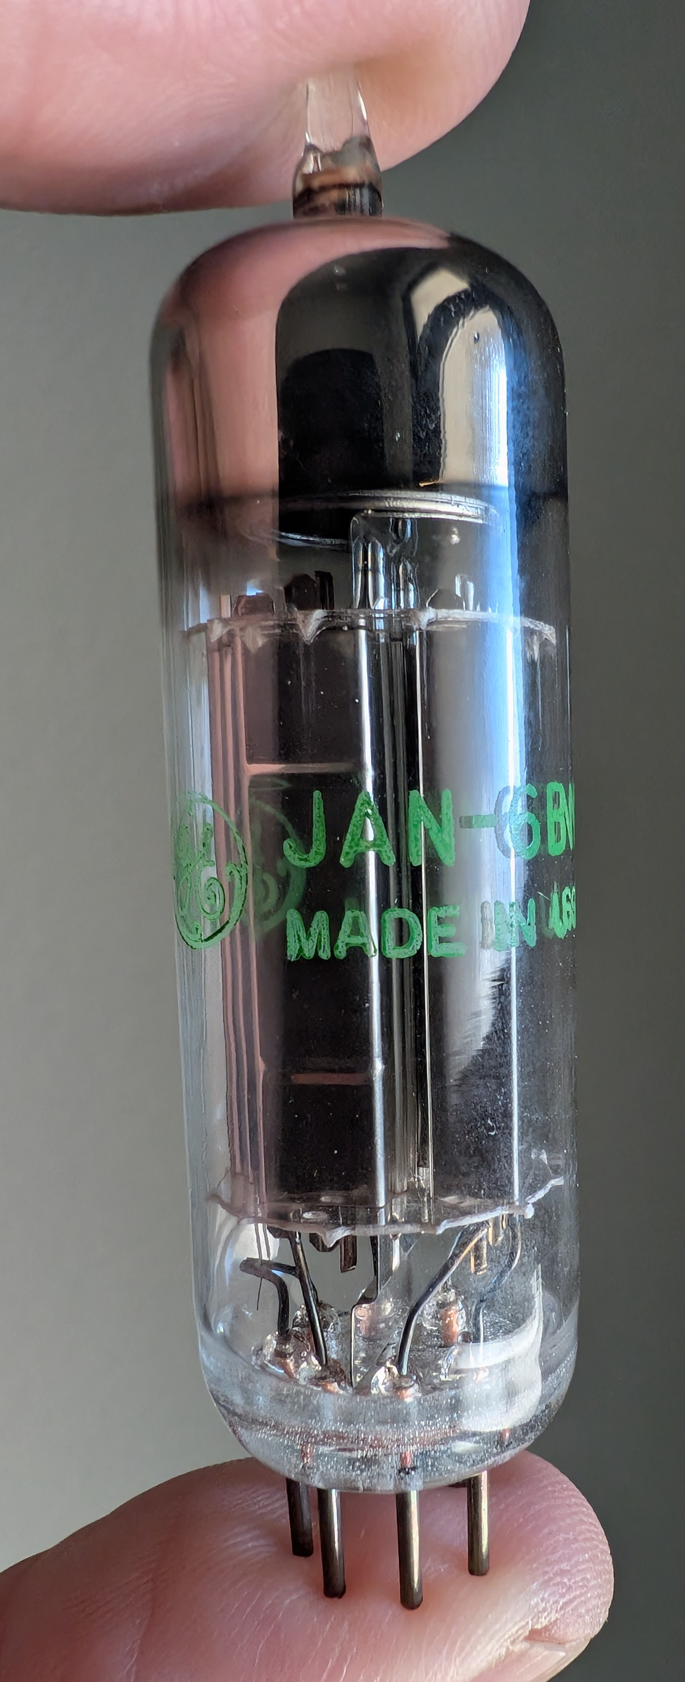
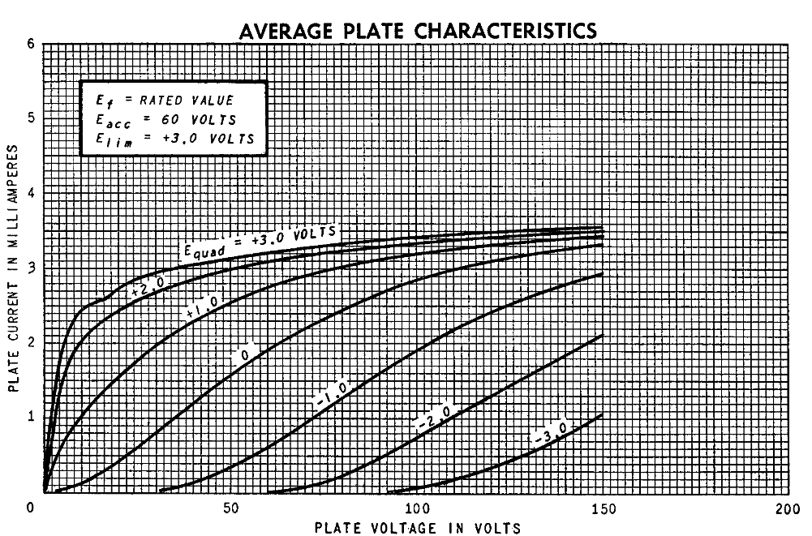
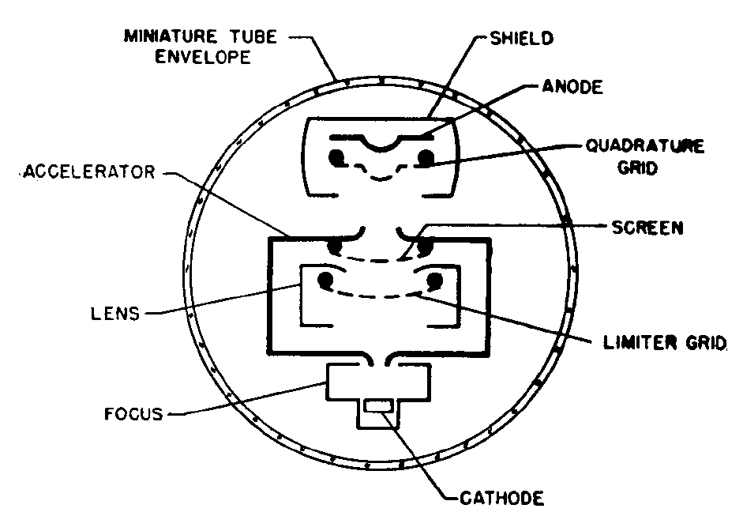
Gated beam discriminators (GBD)
The gated beam discriminator was designed to be a detector in FM radios
It was also used in digital circuits
6BN6 and 6KS6 are examples
The plate curves are… curvy?
I used the 6BN6 GBD in the “magic box” I made to demo even and
odd distortion at ETF.04
Varying the quadrature grid (G3) voltage changes the shape of the G1 curves
GBD cross section
Quadrature characteristic
Notes:
Maybe useful for guitar effects, but probably not so much for hi-fi

Slide 18
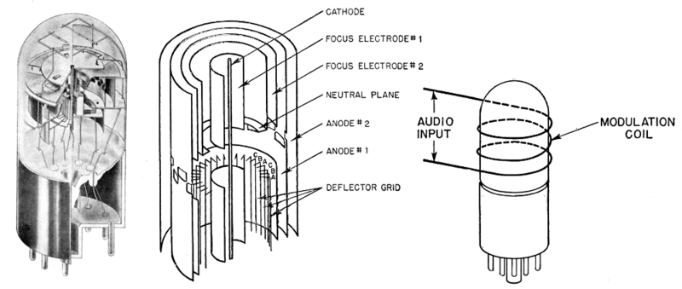
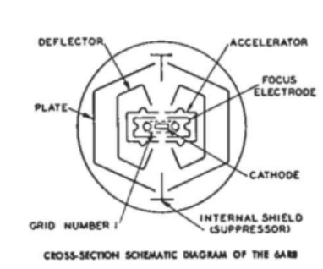
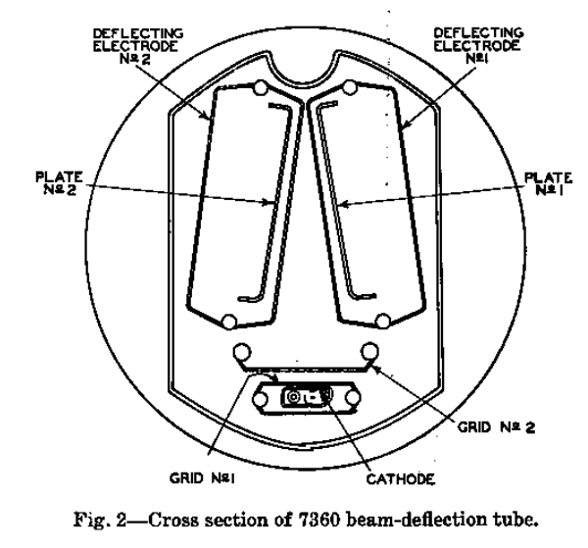
Beam deflection tubes / sheet beam tubes
Beam deflection tubes (BDTs) form an electron beam that can be steered between two (or more) plates
The most common BDTs were used for SSB modulation (7360) and chroma demodulation in color TVs (6AR8/6JH8/6ME8)
It gets weirder from there… like the GE “Phasitron”, an early FM modulator that uses a magnetic field to modulate the phase of a VHF carrier
GE Phasitron tube
BDT cross sections

Slide 19
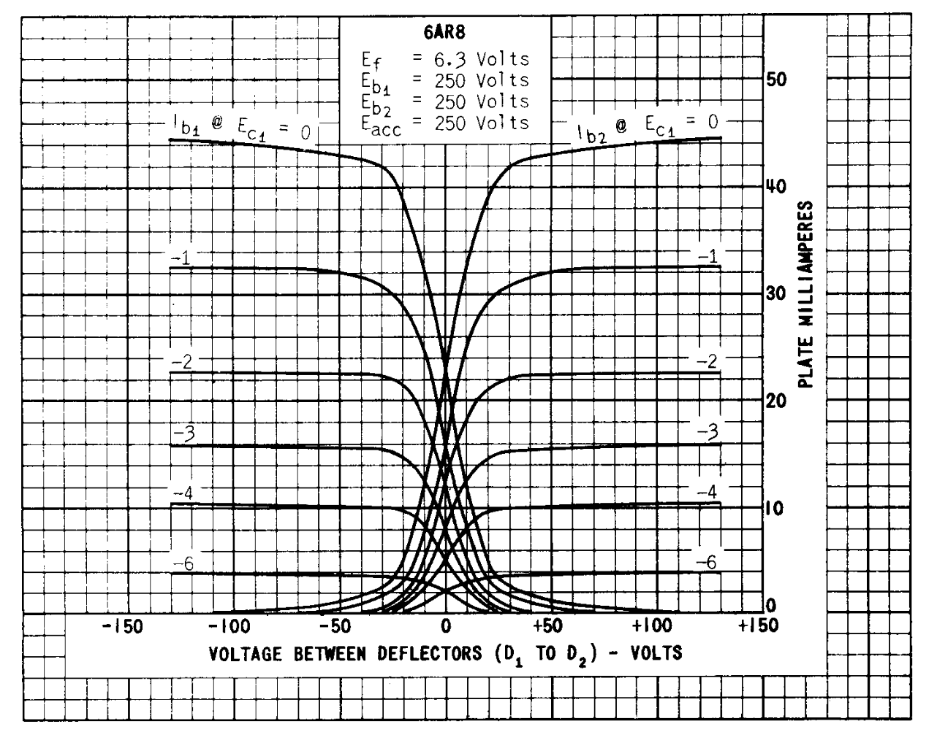
BDT audio applications
The 6AR8 BDT actually has been used for some unique audio applications
JN Van Scoyoc published an article in 1959 suggesting audio applications of the 6AR8
You can make a variable gain amplifier by applying the audio input differentially to the deflectors
Varying the G1 voltage varies the gain (Van Scoyoc claims over an 80dB range!)
In the curves below, see how the slope changes with varying G1 voltage?
Using that principal you can also make compressors with a BDT
Notes:
It seems like there could be other clever applications for these

Slide 20
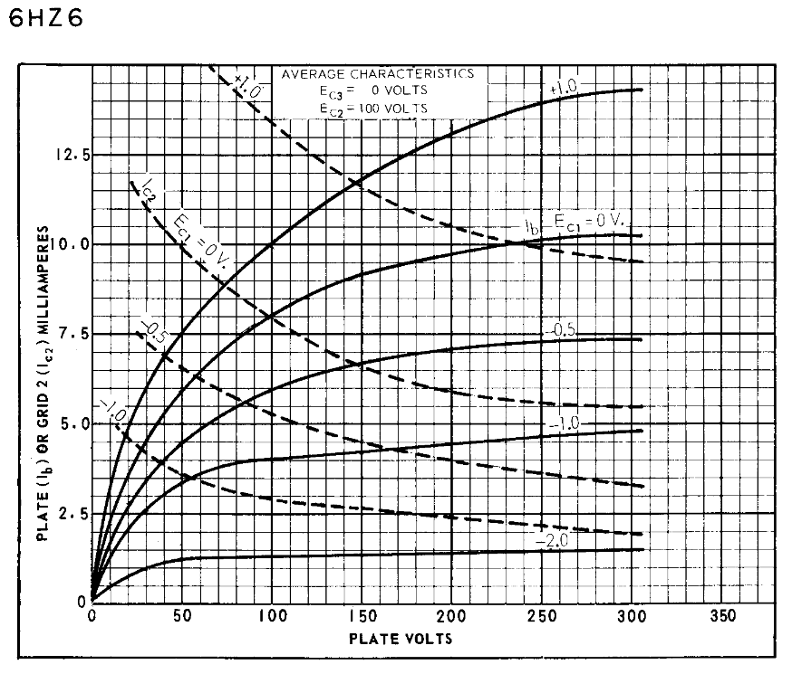
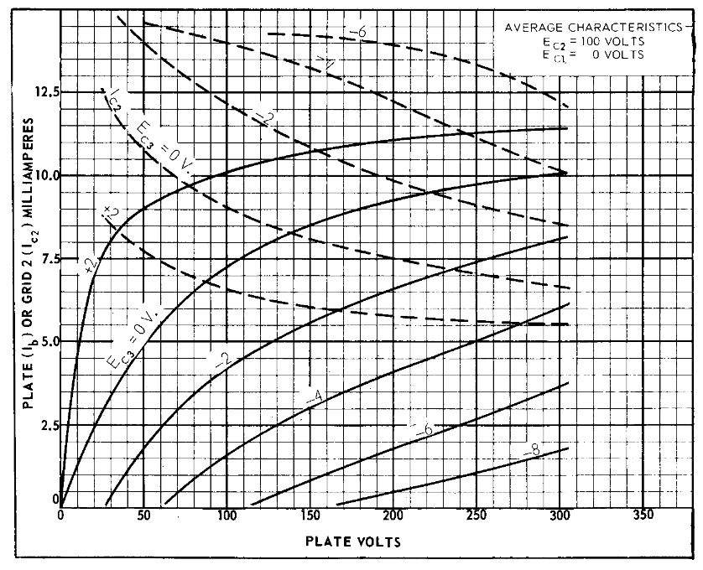
Dual control pentodes (DCPs)
Dual control pentodes are pentodes where G3 is designed to be a control input, not just a suppressor grid
Dual control pentodes include 6DT6, 6HZ6, 6GY6, and 6GX6
These were primarily used as FM detectors in TVs
Providing a positive DC bias to G3 varies the characteristics of the pentode
You can “square up” the G1 pentode curves by finding the optimal G3 DC voltage
Here are G1 and G3 curves for the 6HZ6
G1 characteristic curves
G3 characteristic curves

Slide 21
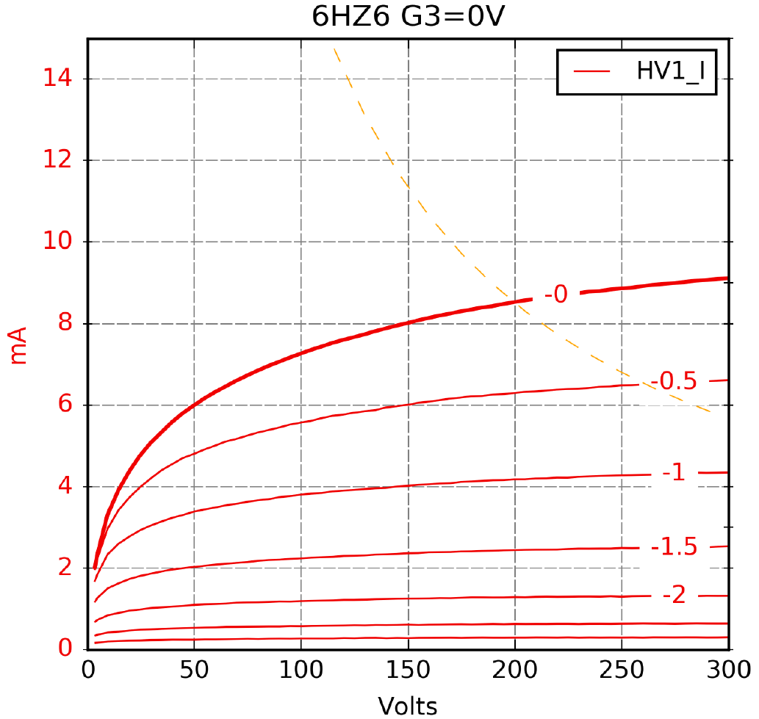
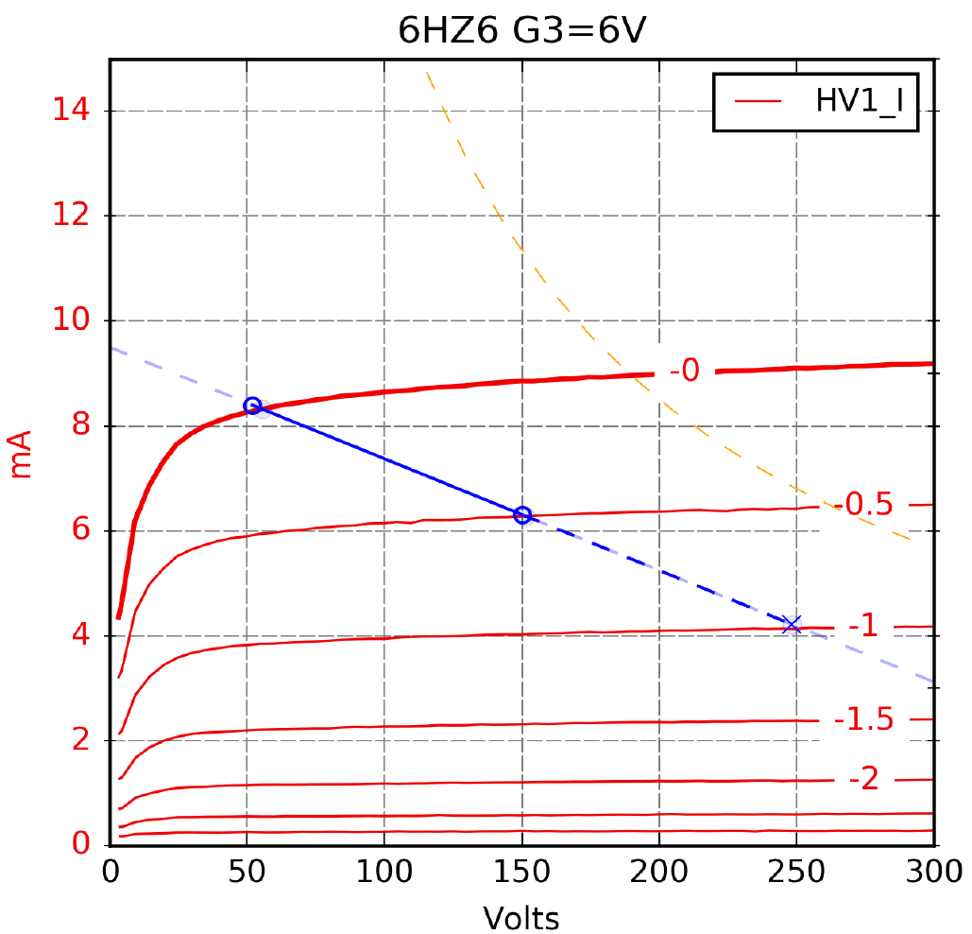
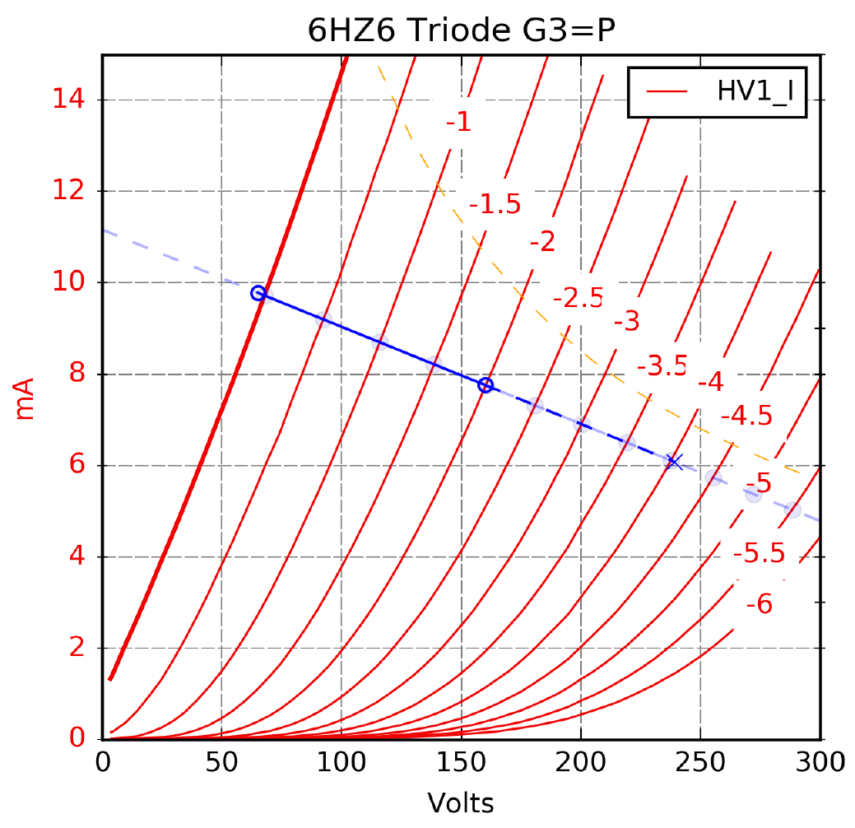
Details: the 6HZ6
6HZ6 is a typical dual control pentode designed for FM sound detector use
The 6HZ6 sells for $0.75 and can make a fine audio tube
As a pentode, with G3=6V, it’s quite linear
With a 47k load, you get a gain of 200 Triode connected (all grids to plate), it has a gm of 7mA/V, rp of 7k, and mu of 52
With a 47k load, you can get a gain around 48
Notes:
Notice how the 6V on G3 “squares up” the curves.

Slide 22
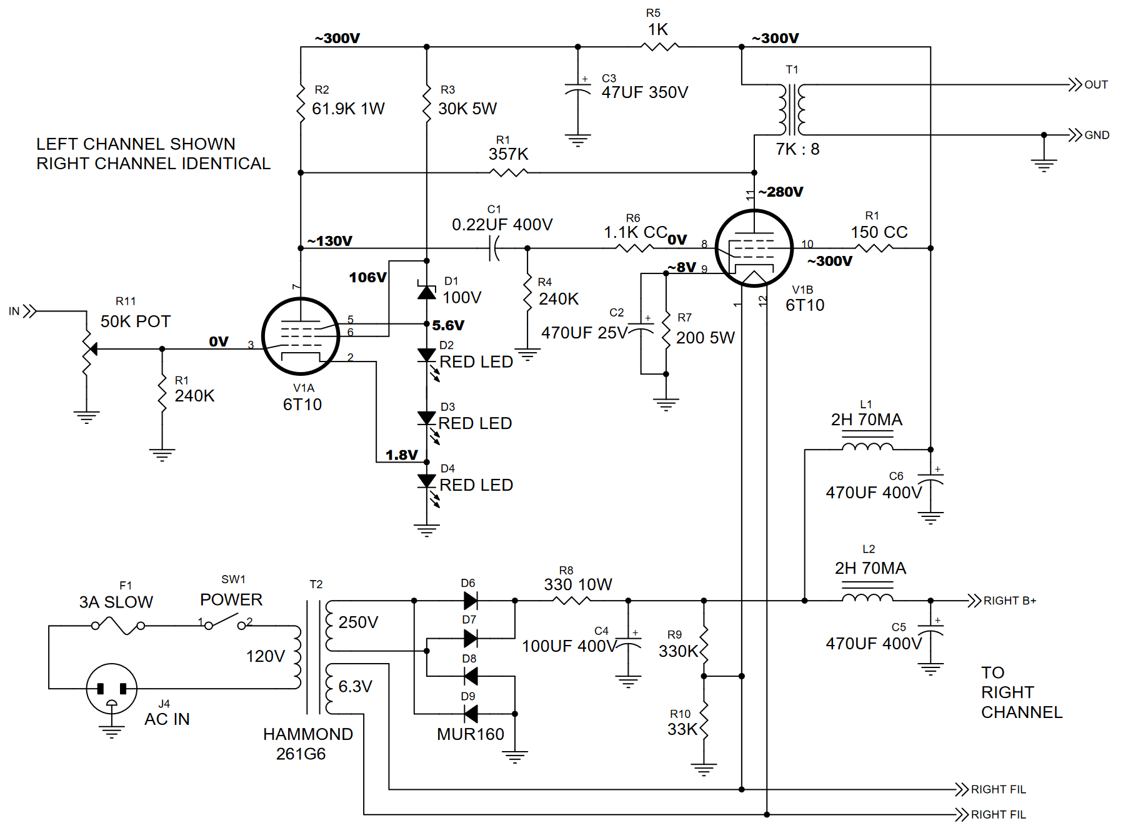
DCP plus audio output pentode
DCPs were also made integrated with an audio output stage in a compactron envelope
They were designed to serve as a quadrature detector plus audio power amp in FM radios
These tubes can make nice single-tube audio amplifiers, using the DCP as a regular pentode
Types include 6AD10, 6AL11, 6BF11, and 6T10
I used the 6T10 in “the mighty midget” amp (audioXpress 5/2008) – the pentode is rated for 10 watts plate dissipation, and 4.2 watts out in single-ended A1 audio amplifier use
Note +5.6V on G3 of the DCP
“Mighty midget” schematic
Notes:
Not the ultimate hifi amp. I designed it for the beginner to be easy and cheap to build.

Slide 23
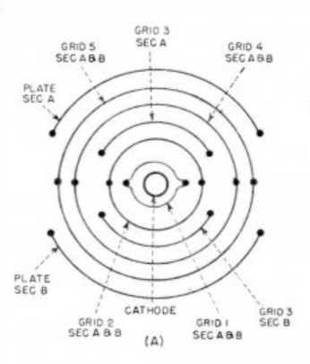
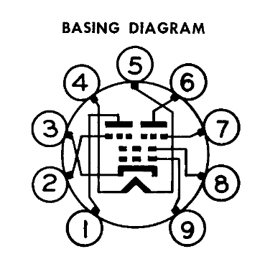
Twin DCP
The twin DCP tube puts two DCPs together, sharing the cathode, G1, and G2, with separate G3 and plate
These were used as color demodulators in TV
Audio uses of these was proposed back in 2003
Morgan suggested that it might be a good CCS for a pair of cathode followers
Biasing up the G3s and connecting the plates together should make a good pentode
Like a single DCP, biasing up G3 “squares up” the pentode curves
Types include 6LE8, 6KF8/6BU8/6HS8, and 6GS8
Also twin DCP plus a triode: 6BA11 and a dual DCP: 6BV11
6LE8 pinout
Twin DCP cross section
Notes:
This one needs further experimentation

Slide 24
Acorn, disc seal, and planar triodes High technology for the space age

Slide 25
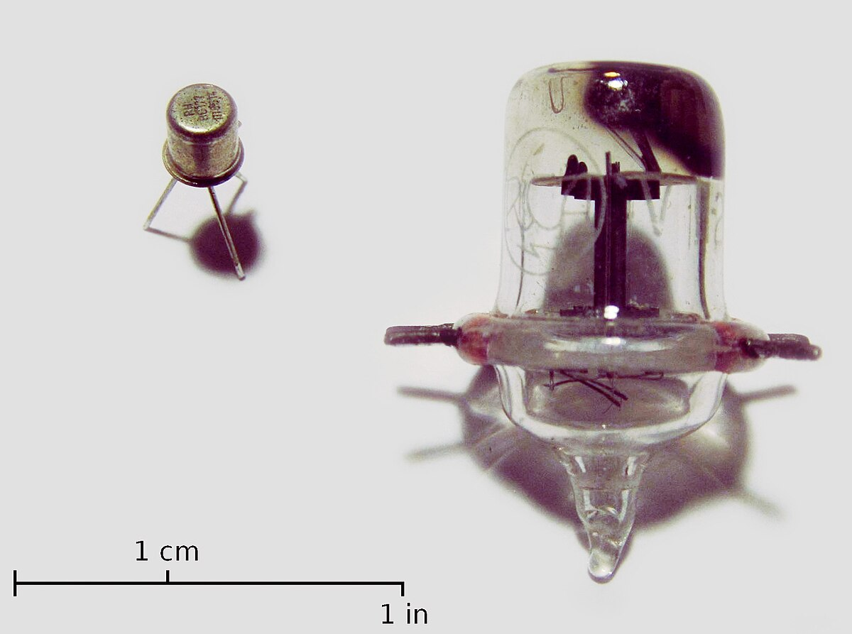
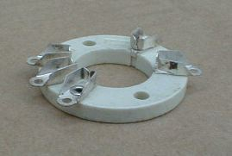
Acorn tubes
Acorn tubes are small glass tubes with a conventional structure inside
There are acorn triodes and pentodes – types 954 through 959 are acorns
The 958 is a very linear DHT acorn
They do take a strange socket – they are available, but cost more than some of the tubes

Slide 26
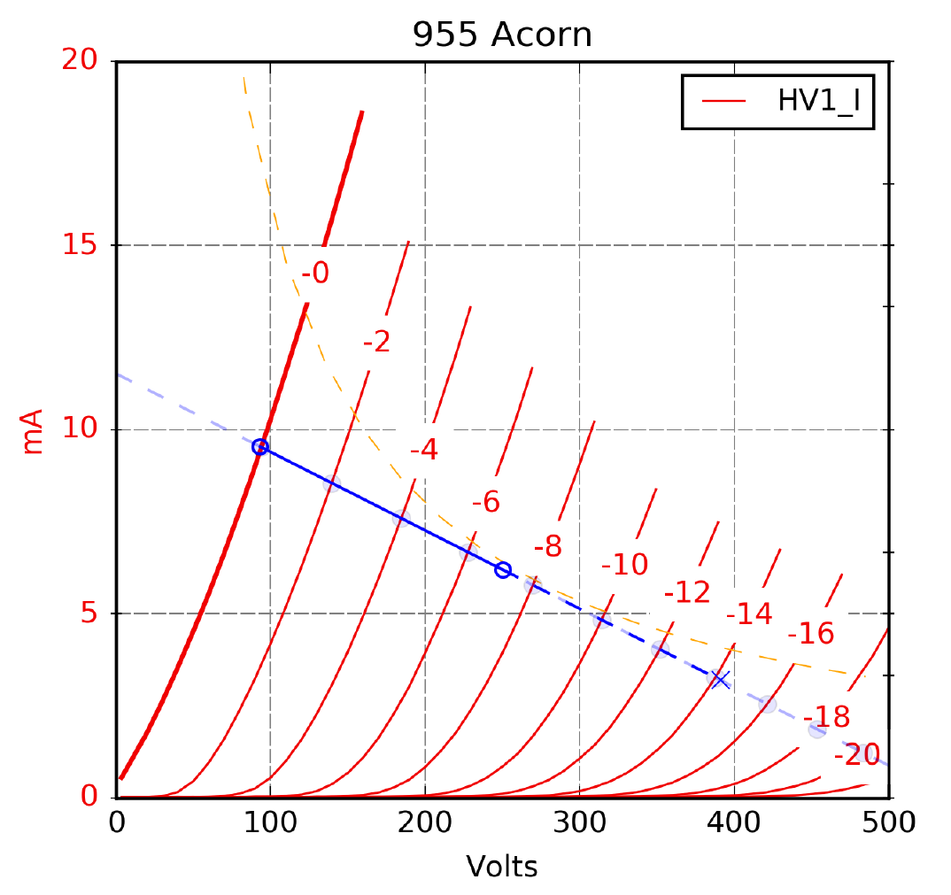
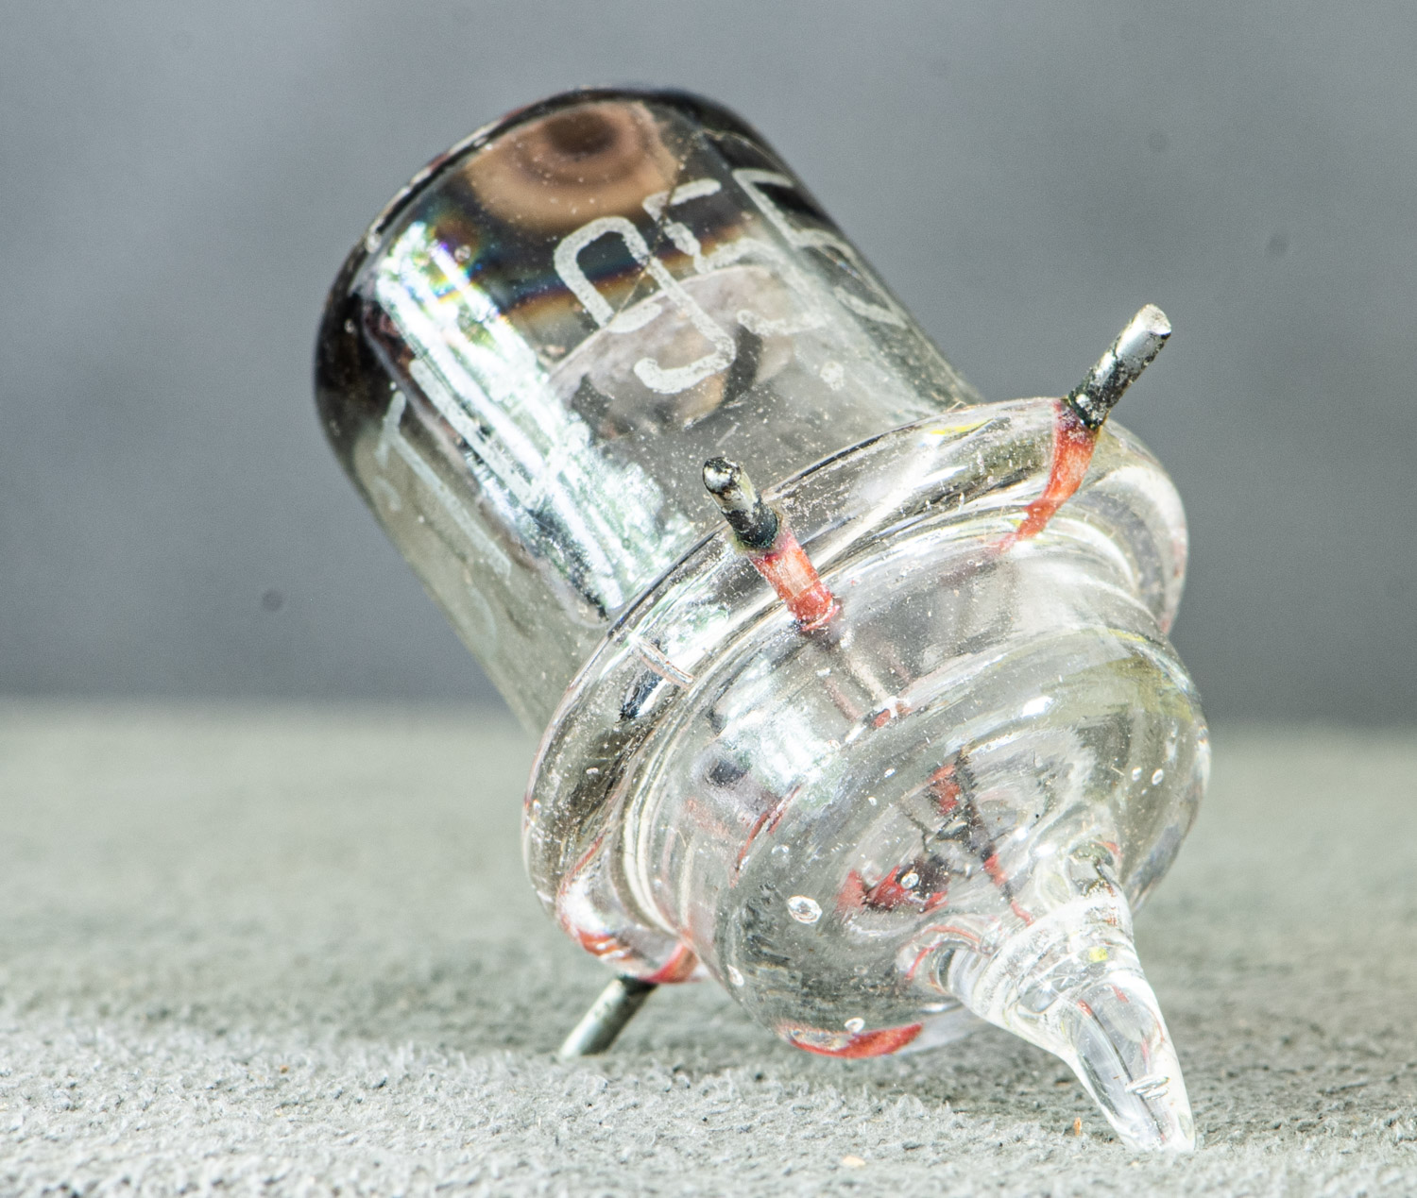
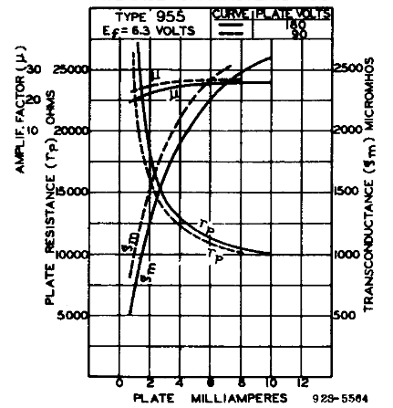
Acorn tube example: 955
The 955 is a common IDHT acorn tube that is actually quite good for audio
The gm is around 2.2mA/V and mu of 25, which is quite flat over current
300V P-P out and a gain of 21 with a 47k load, at 250V 7mA
It’s cheap, around €4.
This appears to be the same tube inside as the 9002 (in 7-pin-mini – it’s also pretty cheap)
Thomas Mayer did a nice writeup on the 955
http://vinylsavor.blogspot.com/2020/06/tube-of-month-955.html

Slide 27
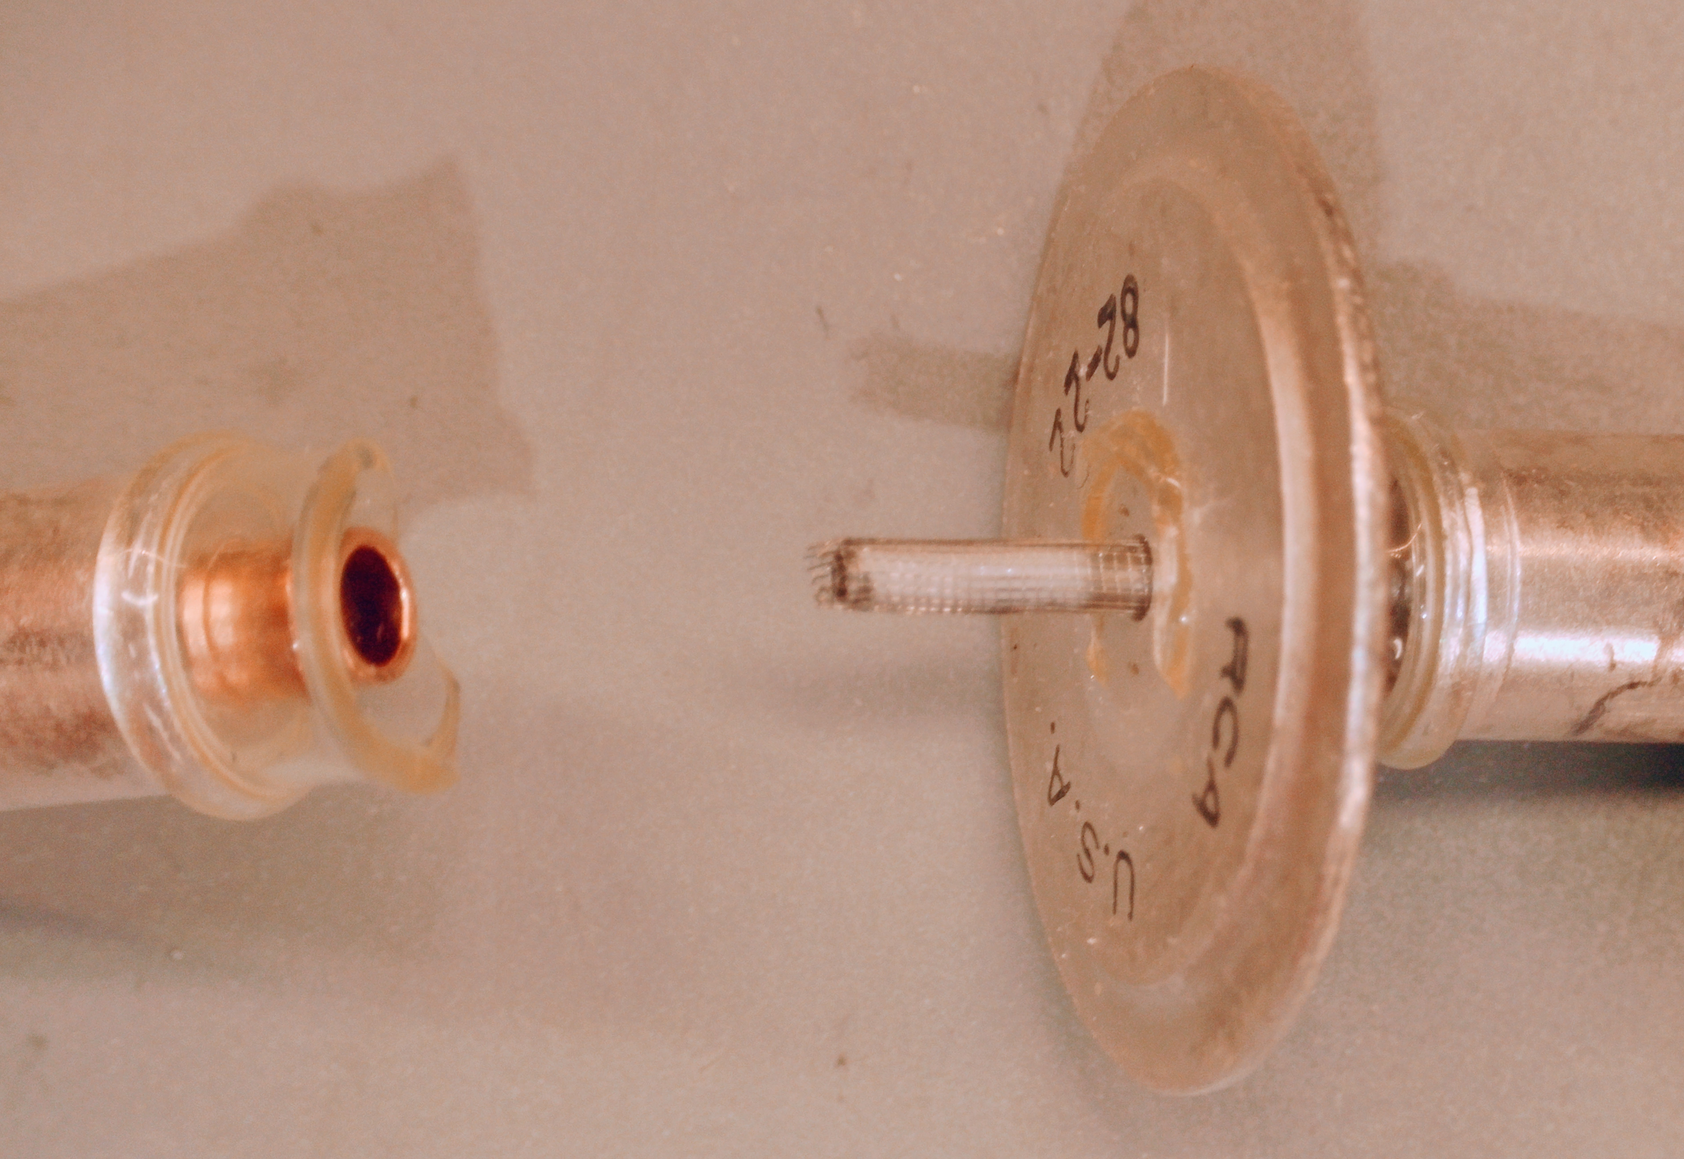
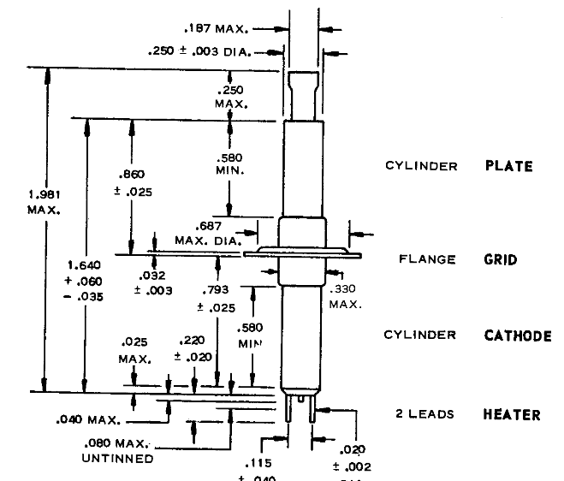
Pencil tubes
A “disc seal” triode, the “pencil” tube is, well, shaped like a pencil. The filament comes out the two pins at the bottom, the plate is the cylinder at the top, and the grid (connected to the disc) is a screen between the cathode and plate.
The 5876 is typical, with a gm of 6.5mA/V and a mu of 56
Also a class-C RF tube…
Notes:
The glass is sealed to both sides of the grid disc

Slide 28
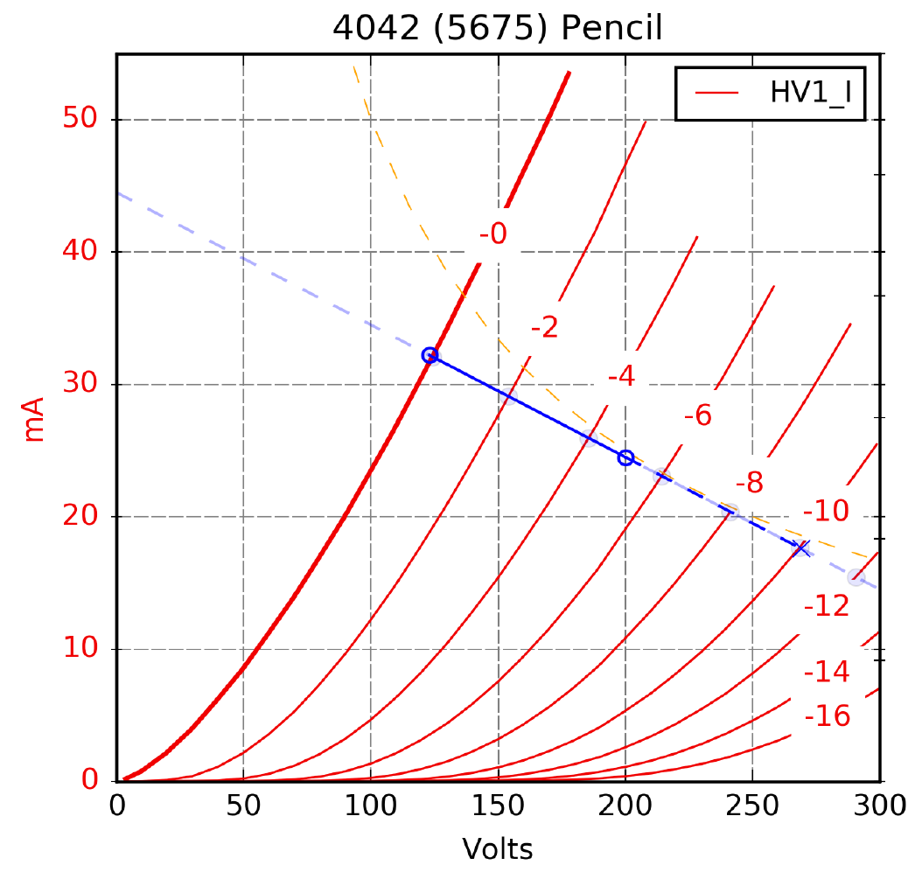
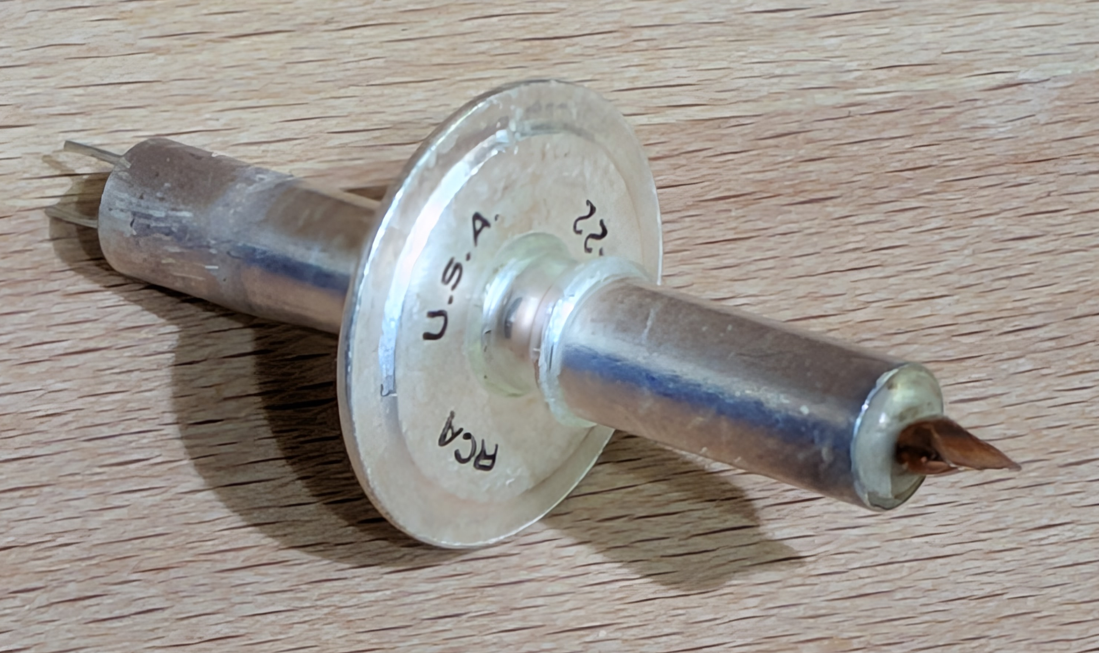
Pencil tube example: 4042
The 4042 is a selected 5675 that was used in HP test equipment
It’s a 5 watt medium mu triode – gm of 6.2 mA/V and mu of 20 (I measured 6.8 and 16)
With a 10k load, 200V Vp and -5V Vg, gain of 15 and max out of 150V P-P
These sell for between $5 and $20

Slide 29
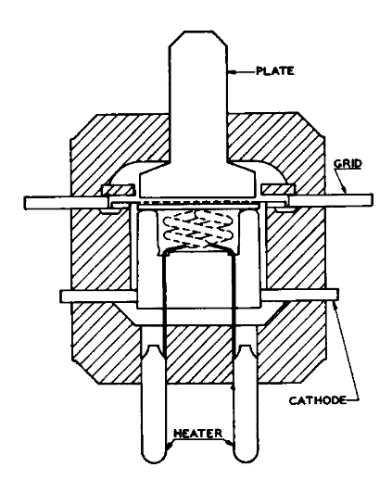
Planar triodes
The quest for UHF and microwave radio led to some really odd triodes
Many of these triodes have a planar structure, as opposed to the concentric structure that other tubes use
The grid structure is a flat array of tiny wires or a thin sheet of perforated metal
The plate is a flat plate
This construction allows very tight spacings and low parasitic inductances
These tubes are not always inexpensive, but they are interesting nonetheless
Some have amazing characteristics

Slide 30


Lighthouse tubes
The lighthouse tube is an early example of a planar triode
The 100 watt 2C39 is quite common, with a gm of 24.8mA/V and mu of 95
Other 2Cxx tubes are similar, with different gm and mu
Since most were intended for class-C RF use, most of these are maybe not so useful for audio…

Slide 31



Metal / ceramic triodes
Planar triodes can also be constructed using ceramic and metal
These are recent developments from the mid-late 1960s through the 1980s
Some can be soldered directly into a PCB
Many are medium mu, high gm, and could be useful in audio
These include 7625, 7296, 7462, 7720,
7296, 7588, 8081, 8082 and 8083 can be mounted on a heatsink
7588 has a gm of 45 mA/V and a mu of 175!
Some of these are expensive, some are not
8082 tube
Heatsink mounting
7625 tube

Slide 32

Really high performance…
The 7768 metal/ceramic tube has a mu of 100 and a gm of 50mA/V!
It is not cheap – around €100 – but compared to an EC8020 which is selling for €1,000 – €5000 each, not so bad
It should make a great phono stage
Planar ceramic structure
7768 tube

Slide 33
Multi-element tubes Tubes with 2, 3, or 4 tubes inside

Slide 34
Triode-diodes, triode-pentodes, etc.
Not exactly odd, but there are many multi-element tubes out there that are neglected by audio designers
In the later development of tubed televisions, many tubes were developed with more than one tube element inside one envelope to save money
Triodes and pentodes with diodes, and triode plus pentodes are very common
Triode/diode and triode/pentodes were used as an AM detector and audio amp
Triode / pentodes are a “sweet spot” because they fit in a 9-pin miniature envelope, so there are probably 100 types
Many of these re-used the guts of standard audio tubes
An example: 6AQ7 triode plus dual diodes has ½ of a 6SL7 inside. It costs €3 vs. €30
Another example: 6LY8 has ½ of a 12AX7 inside… and it sells for $3
Some of these tubes have incredibly good specs
That 6LY8 also gets you a frame grid pentode with a gm of 20mA/V!
There are HUNDREDS of useful tube types like this
…and even more if you are willing to use odd heater voltages

Slide 35



6JT8 and 6LY8
The 6LY8 is about $3.00. The very similar 6JT8 is $0.75.
This is a 12AX7
Gm of 20mA/V!
Notes:
This is just one example…

Slide 36


6LY8 A2 driver
Notes:
Makes a great SE driver. This one is for A2.

Slide 37

That’s it…
Go find some odd tubes!
Questions?
Comments?
Notes:
That’s the 6LY8 driving an RAF VT-62 (4304CB)

